Slide 1
ER Diagrams (Conceptual, Logical)
Team 2: UnitFit

Slide 2
Team 2: UnitFit
ER Diagram (Conceptual)
Recipe ID
Email
Password
Name
calories
User ID
consult
Recipe
Customer
User ID
image
Selects
use
User ID
Dashboard ID
Hip
Date
Waist
image
User ID
Gender
Left Upper Arm
content
Ads and Promo
Height
Dashboard
Right Upper Arm
Weight
Ad’s ID
link
Left Thigh
Calorie Intake
Chest
Neck
Note
Right Thigh

Slide 3
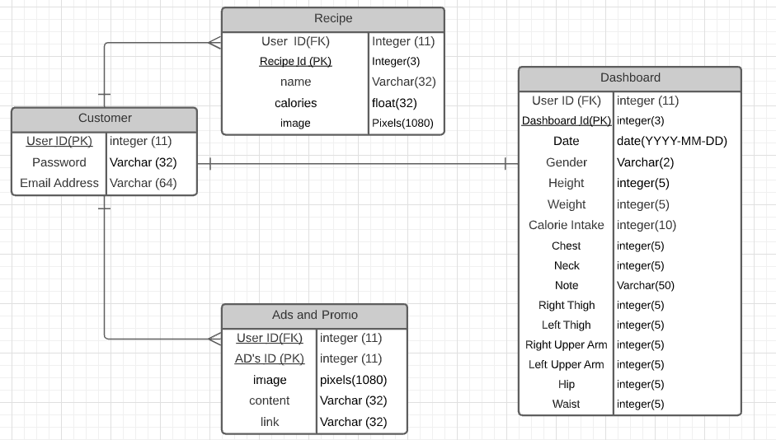
Logical ER diagram
ER Diagram (Logical)

